Slide 1
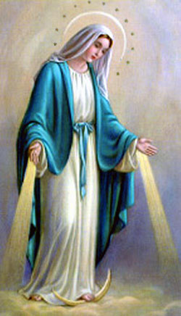
Teams of Our Lady, Birthday Celebrations.
Vigil Mass for the Feast of the Immaculate Conception
Saturday 7th December 2019 @ 18.30
Avila Carmelite Centre, off Morehampton Road, Donnybrook, D04 T9C8
72nd Birthday Party afterwards with finger food, tea, coffee, friendly chat and catch up. Don’t miss it!
Invite a friend.
Get working on your favourite goodies and bring them along.
Donation appreciated

