Slide 1
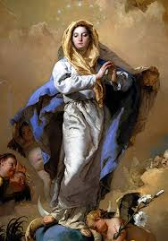
Teams of Our Lady Celebrations
Mass for the Feast of the
Immaculate Conception
Friday 8th December 2023 @19.30
Our Lady of Perpetual Succour Foxrock D18 N2F7
Birthday Party of Teams afterwards, with finger food, tea, coffee, friendly chat and catch up. Don’t miss it!
Invite your friends. All welcome!

